Slide 1
PATHWAYS
HIGH-PERFORMING WEEK
TOOLKIT⎯

Slide 2
Assess how much time is spent in each time category - A, B and C
STEP 1: ASSESS YOUR TIME ⎯
A Time – Strategic | Time allocation - Current % | Time allocation - Desired %
B Time – Leading | Time allocation - Current % | Time allocation - Desired %
C Time – Operational | Time allocation - Current % | Time allocation - Desired %

Slide 3
STEP 2: MAP YOUR HPW⎯
Map your high-performing week (HPW)
HIGH-PERFORMANCE TRACKER
Day
AM
PM
Monday
Tuesday
Wednesday
Thursday
Friday

Slide 4
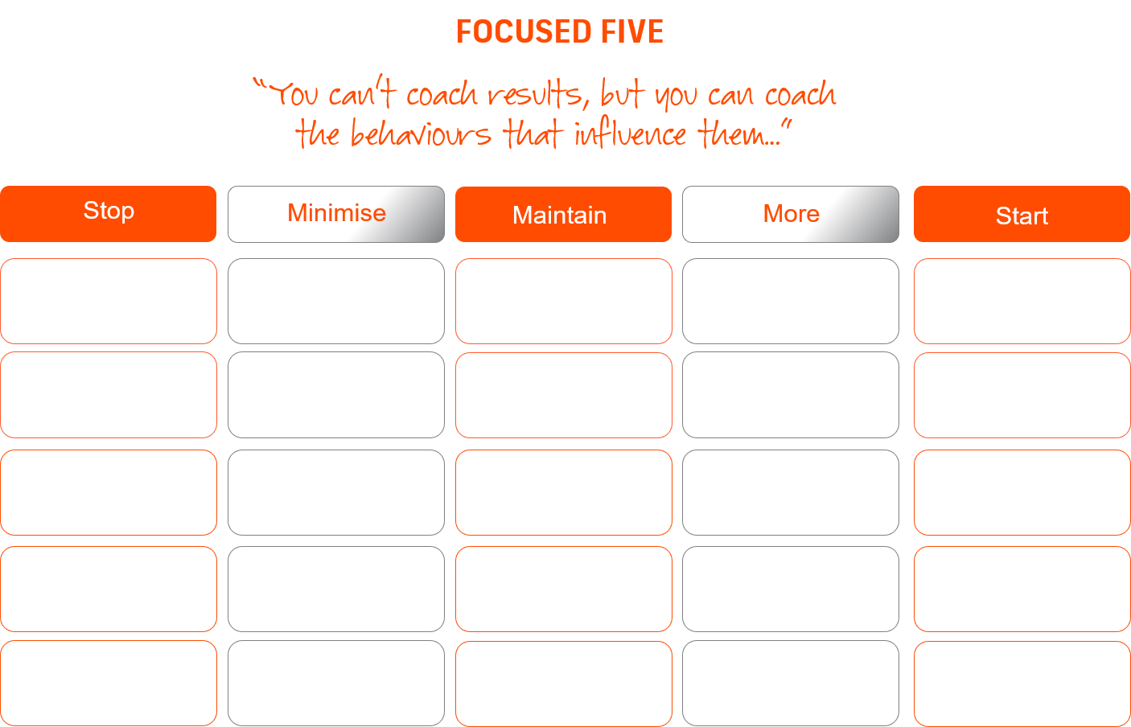
STEP 3: MASSIVE ACTION⎯
Identify quick wins and marginal gains in five focused areas...

Slide 5
Pathways Global Ltd 2019 ©

